Slide 1
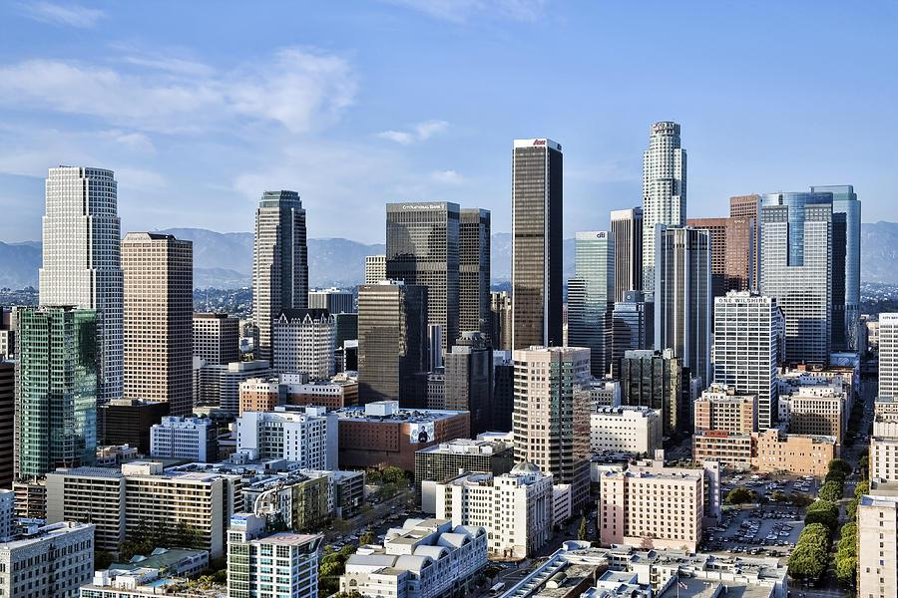



MyLA 311 Service Requests:
Enhancing Customer Service
December 7, 2016

Slide 2
Los Angeles 311
Data Preparation
Data Visualization
Insights and Analysis
Recommendations
AGENDA | 2

Slide 3
MyLA 311
The ‘Submit Service Request’ Feature
Improve the Department’s efficiency
LOS ANGELES 311| 3
Notes:
MyLA 311 Links Angelenos with the services and information to enjoy their city, beautify their community and stay connected with their local government.
‘Submit Service Request’ feature allows you to quickly and easily request the City’s most popular services, including graffiti removal, pothole repair, and bulky-item pickup.”
Through data visualization methodologies and techniques, how can we uncover potential problems for MyLA 311 and improve the department’s efficiency in servicing the residents of Los Angeles.

Slide 4


Two Data Sets:
311_Call_Center_Tracking_Data
2011-2015
MyLA311_Service_Request_Data_2016 (2016)
Difficulty with inconsistencies in reporting system 2011 to 2016:
Number/format of variables
Merging issue
DATA PREPARATION | 4

Slide 5
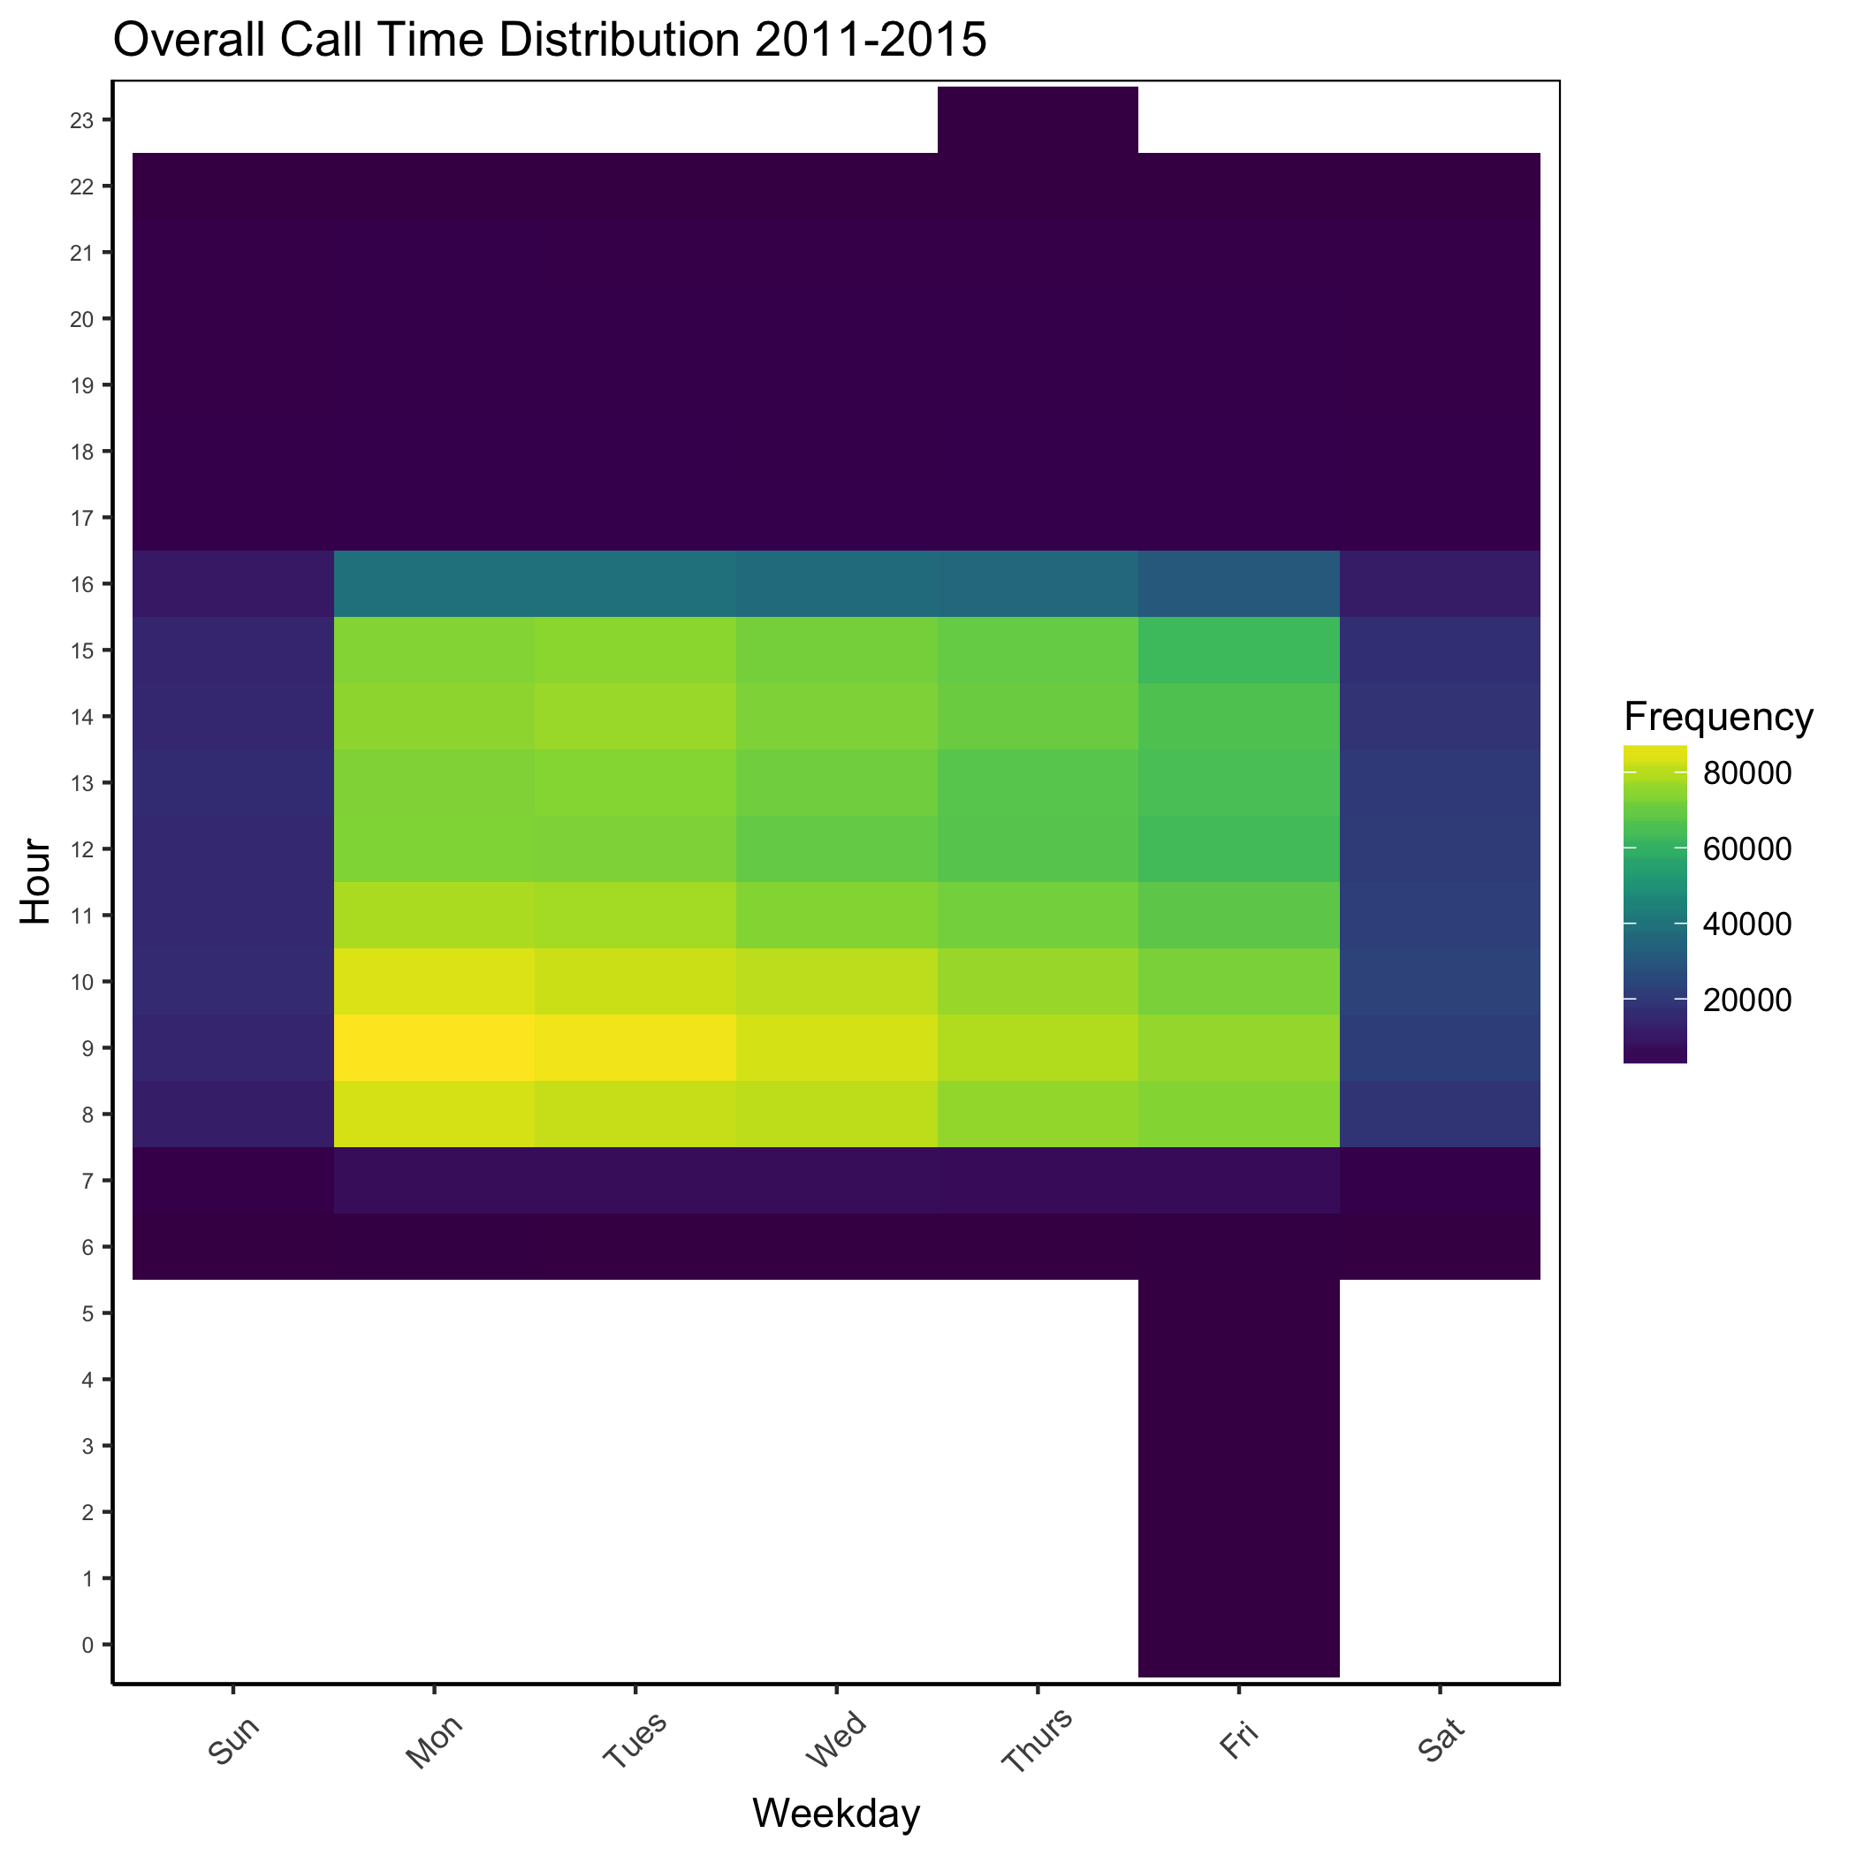
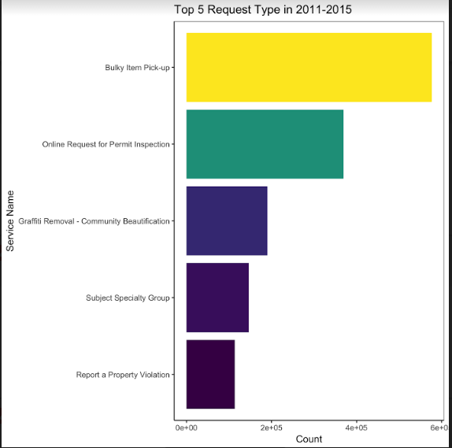
Data Visualization: Exploratory Analysis
DATA VISUALIZATION | 5
Notes:
2011 - 2015 Data
Top 5 request types:
Bulky item pickup
Online Request for permit inspection
Graffiti removal
Subject specialty group
Report a property violation
Time Distribution 2011 - 2015
Busy hours aggregated in the morning (8-10AM) in the first few days of the week

Slide 6
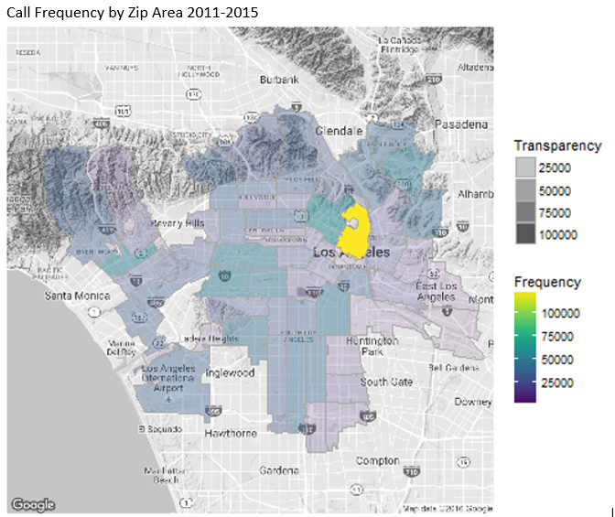
Data Visualization: Exploratory Analysis
DATA VISUALIZATION | 6
Notes:
Zip Code 90012
found unusual spike in 90012

Slide 7
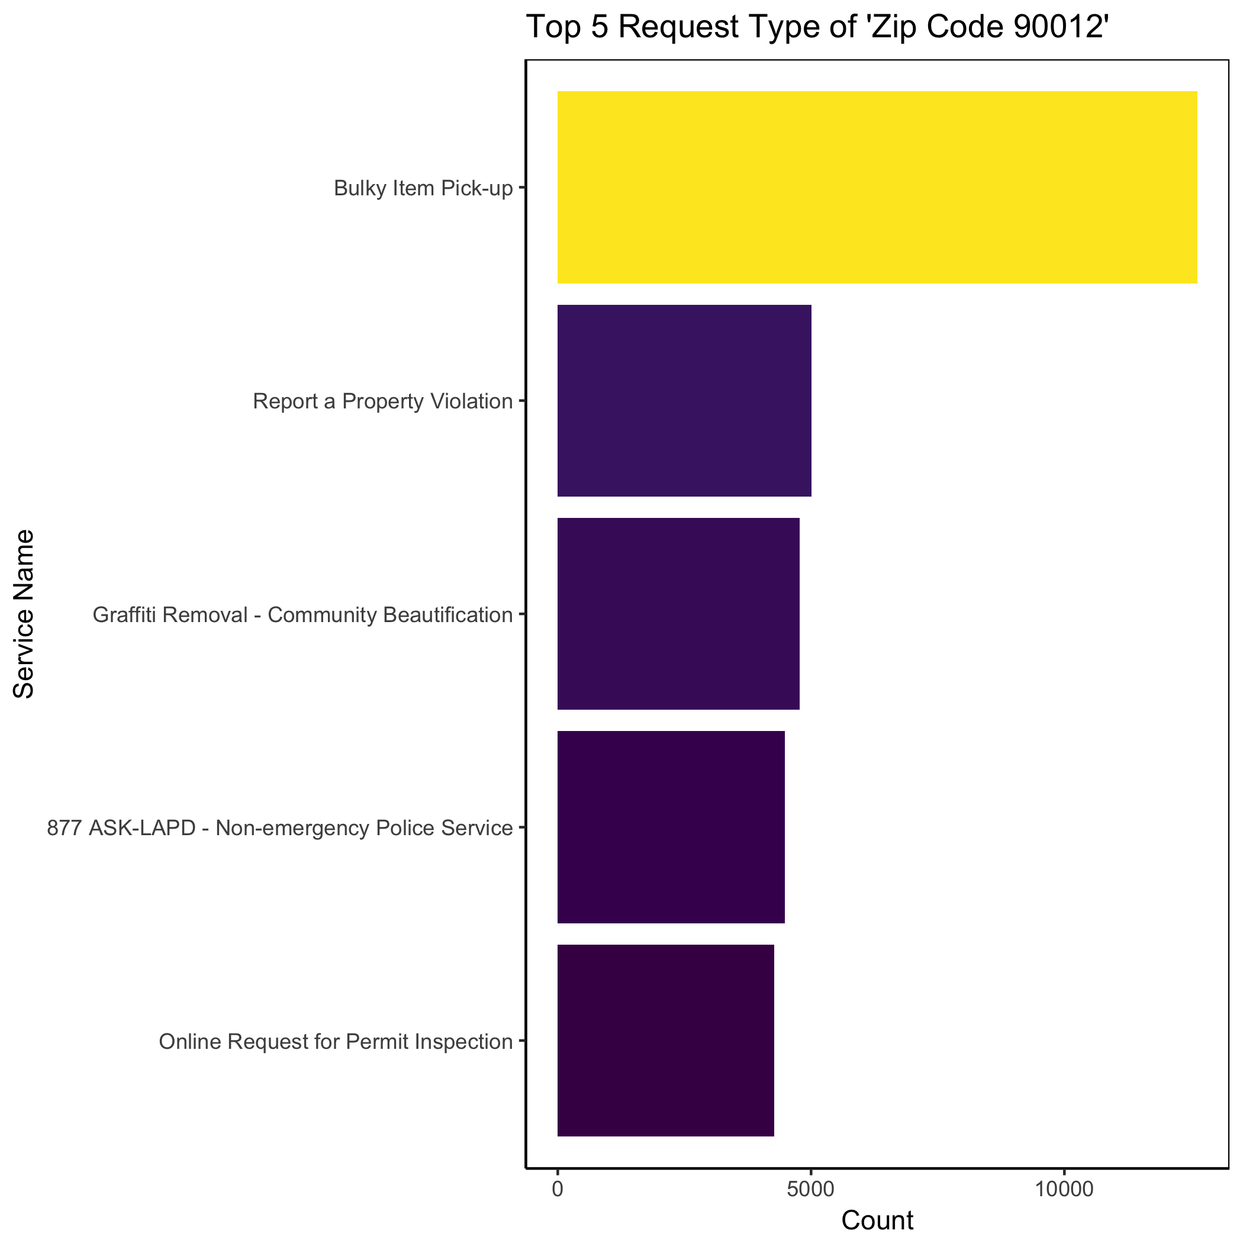
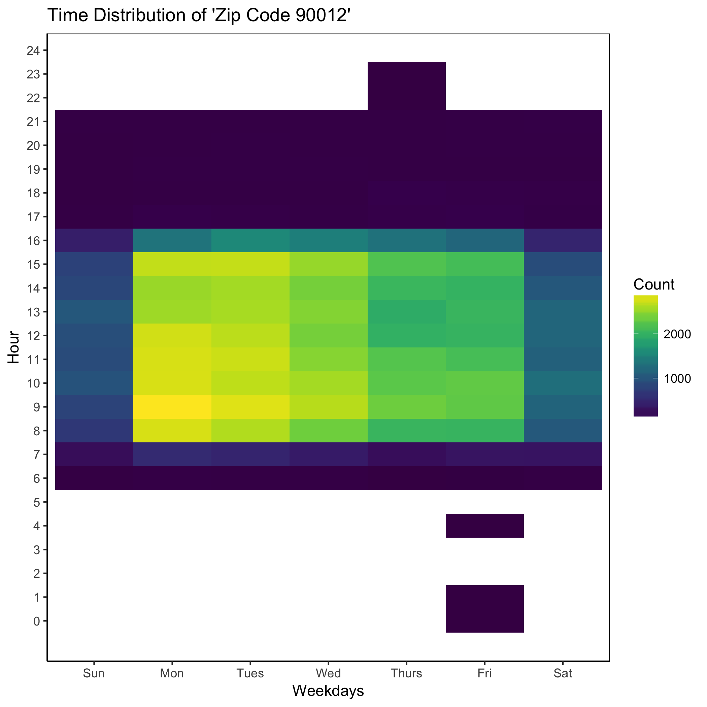
Data Visualization: Zip Code 90012
DATA VISUALIZATION | 7
Notes:
Analysis
overall service type count in 90012
proportionally less request for graffiti removal & property inspection
time distribution in 90012
parallel with overall analysis
Transition: How does this compare to the overall dataset

Slide 8
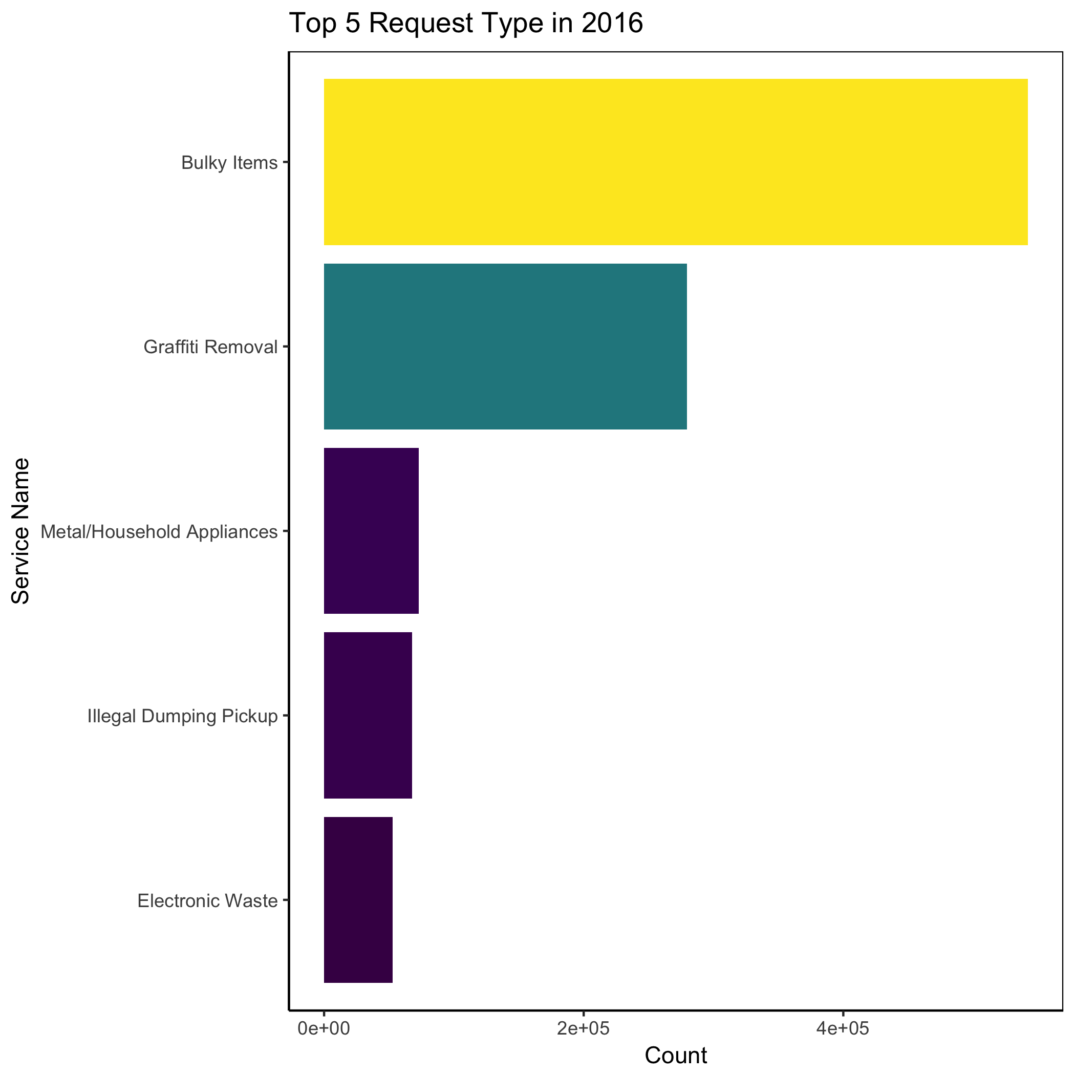
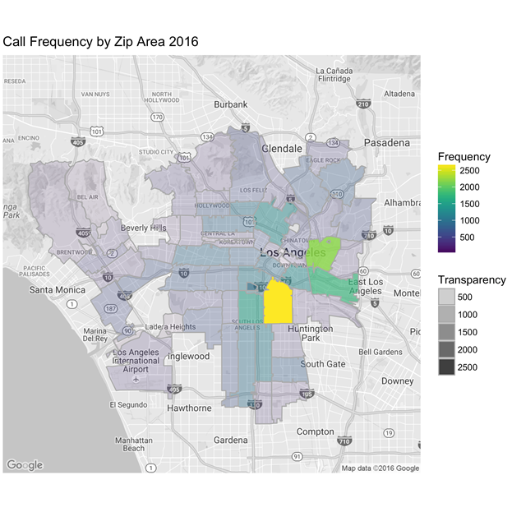
Data Visualization: 2016 Data
DATA VISUALIZATION | 8
Notes:
Overall trends
proportionally a lot more graffiti removal
Deviation from 2011-2015 trends due to inconsistency in dataset
unusual spike in 90011
What’s happening in Zip Code 90011?

Slide 9
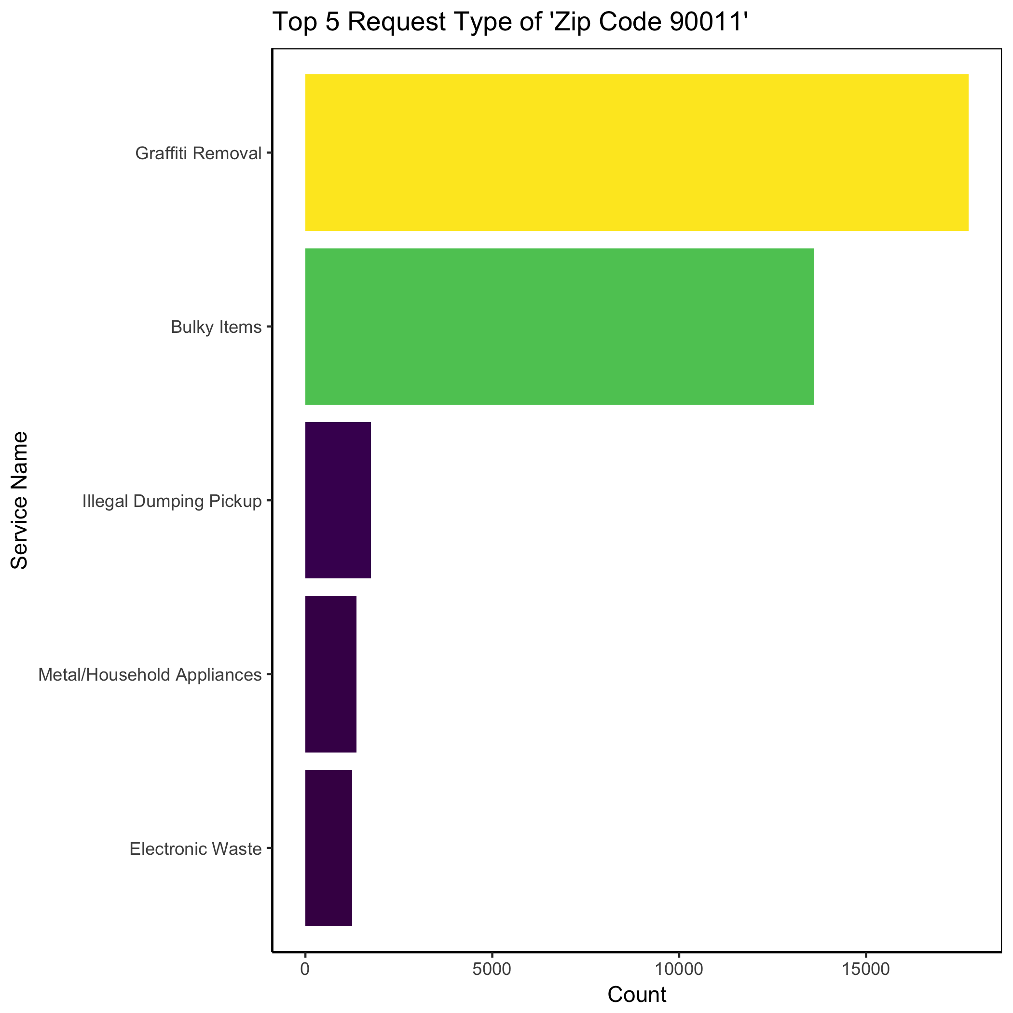
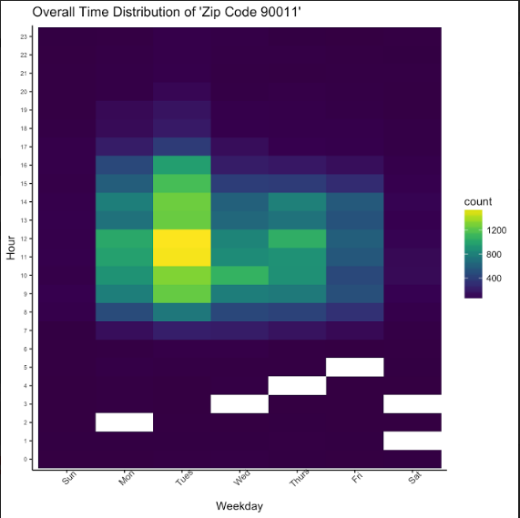
Data Visualization: Zip Code 90011
DATA VISUALIZATION | 9
Notes:
Trends
Deviation from the rest of 2016
graffiti removal goes top
Deviation from the 2011-2015 dataset
Time distribution for 90011
aggregated on Tuesday 11-1

Slide 10
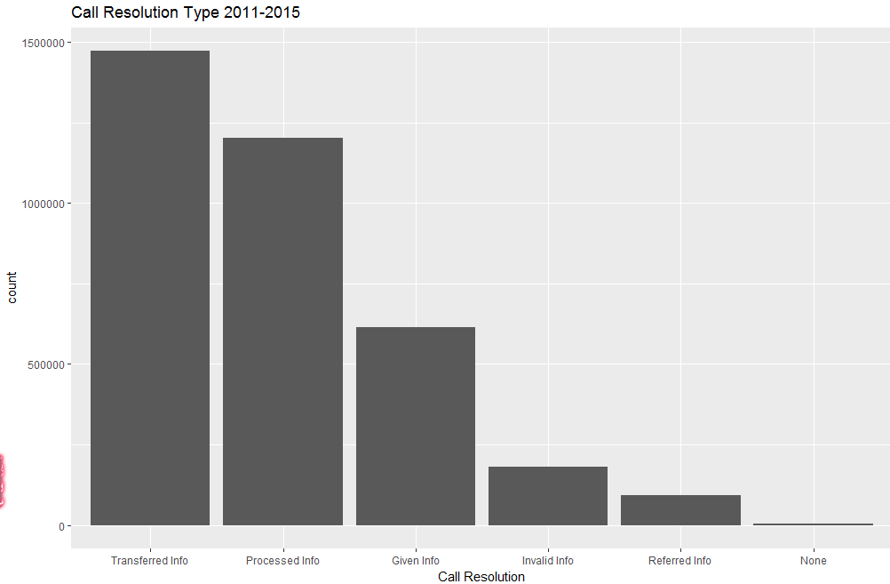
Data Visualization: Call Resolution
DATA VISUALIZATION | 10
Notes:
Invalid (Unsuccessful) call resolutions
consists of: no information given, voice mail, line busy, and hung-up
%5 of overall

Slide 11
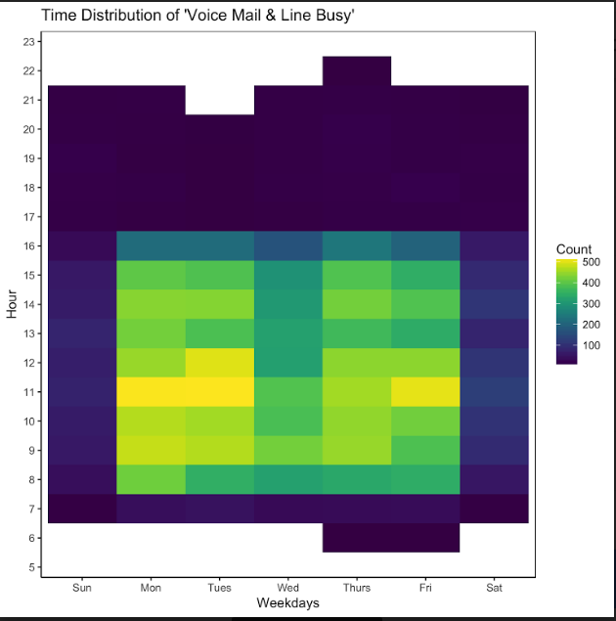
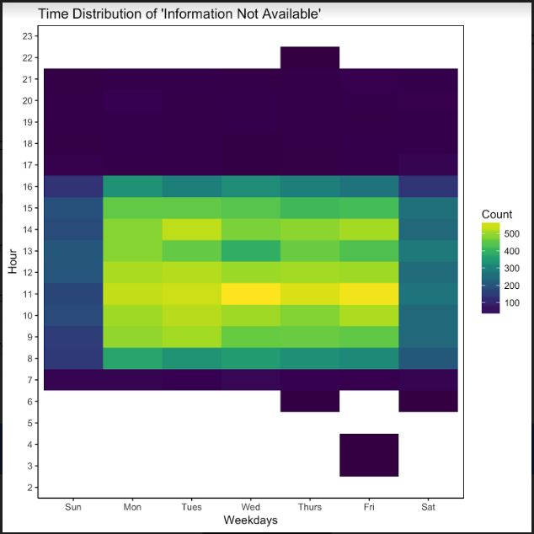
Data Visualization: Call Resolution
DATA VISUALIZATION | 11
Notes:
trends of unsuccessful outcomes around 11 to 12 throughout the week
lunch time?
staffing issue?

Slide 12
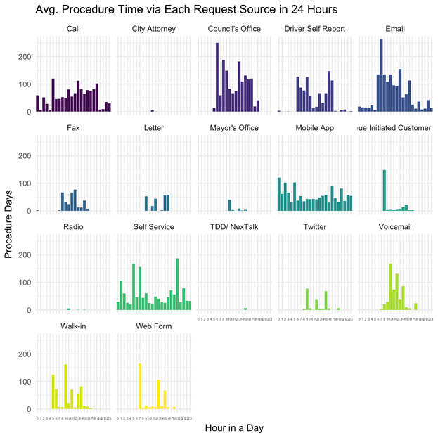
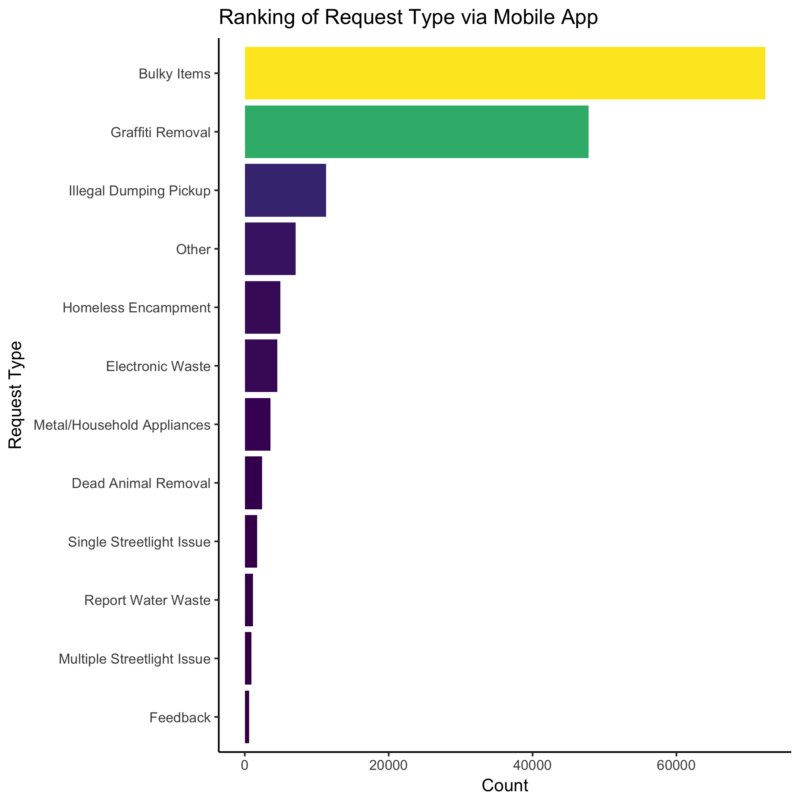
Data Visualization: Mobile App
DATA VISUALIZATION | 12
Notes:
digital trends
utility: 14%
Ranking similar to overall, indicating capability of mobile functions
Average process time is much normalized and evenly distributed throughout the day

Slide 13
Insights and Recommendations
Human Resources Allocation
Highly concentrated request area
Focus on servicing 90011 zip code
Mobile app appears to be successful
Something to continue build out as it increases operational efficiency as people move more towards a mobile adaptation of services.
Focus on graffiti removal in the area
Few respondents available during 11am-1pm
INSIGHTS| 13

Slide 14
Thank You
Q&A
Q&A | 14

